Slide 1


Slide 2

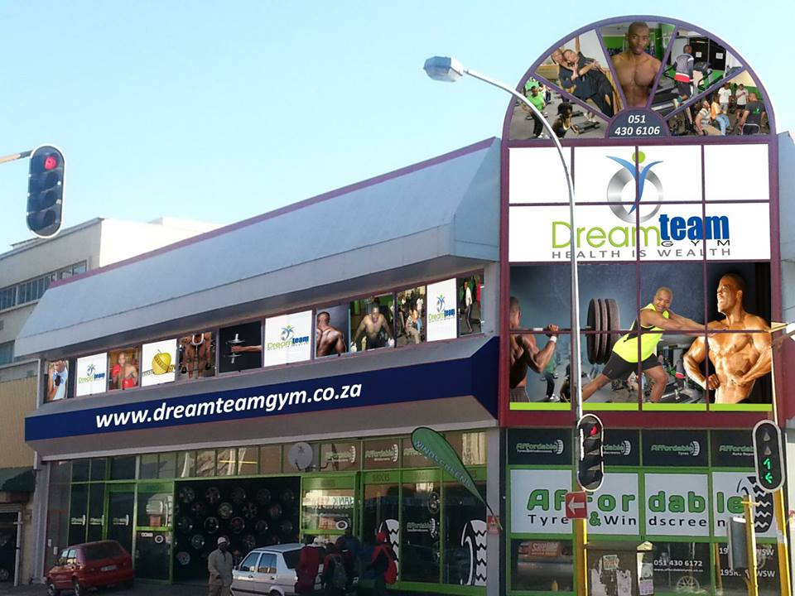
TABLE OF CONTENTS
Rural Demographic
Inadequate Facilities
Development Of Boxers
Transformation
Sponsorships for Boxing
Conclusion

Slide 3
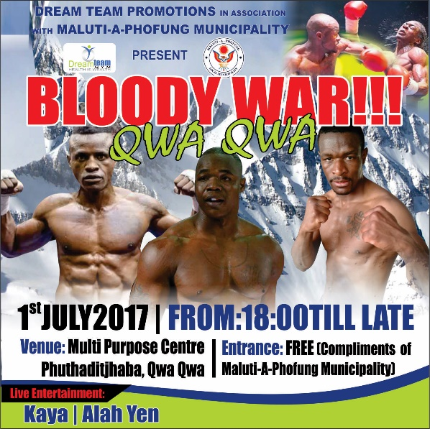
RURAL DEMOGRAPHIC
A state of development or lack of BOXING IN THE RURAL AREARS
In the Free State based areas, the demographic of the towns are far to travel due to vast distances to stage boxing events ( for example) ; from Bloemfontein to Qwaqwa you will have to travel at least 69 km, and from Bloemfontein to QWAQWA Approximately 468 kms.
Promoters Demographics
33 EL
21 GP
3 FS
The above indicates the serious challenge facing BSA to even the playing field

Slide 4
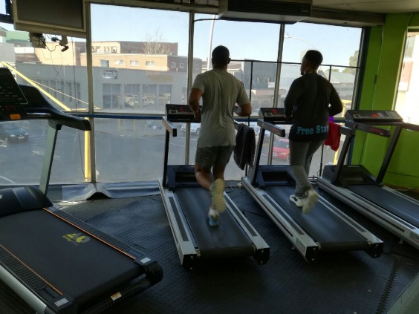
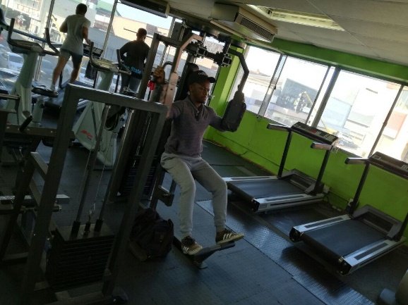
INADEQUATE FACILITIES
Facilities are not sufficient enough for development of boxing, which hinders the number of professional boxers registered in rural areas. This directly impacts on number of boxers produced per province
High number of boxers are produced urban arrears such as Gauteng, East London and Cape Town to name a few, few boxers produced in rural areas migrate to big cities.
Provincial Titles are left vacant due to the lack of boxers produced. We find promoters stage tournaments with boxers from urban areas.
Officials are not adequately developed in rural areas, such as Free State, this affect the promoter in that he has to pay more for officials from other Urban Arears.

Slide 5
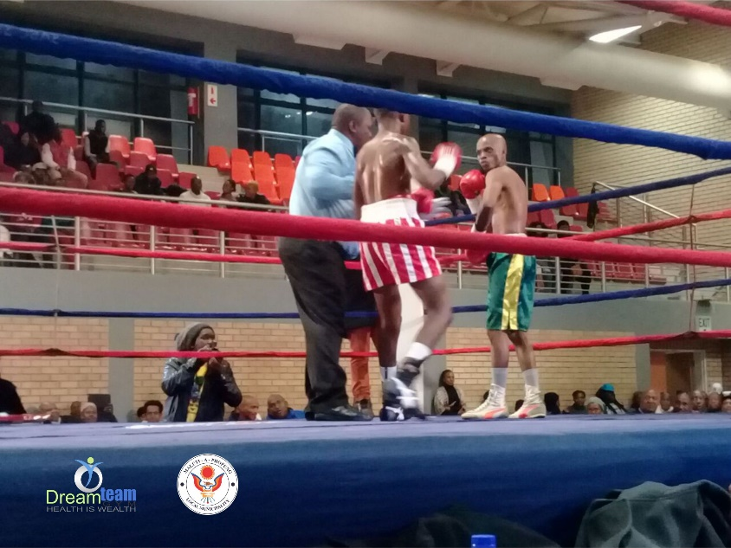
DEVELOPMENT OF BOXERS
The quality of boxers produced in rural arears is poor in comparison to those of urban areas.
Reasons being poverty, malnutrition, lack of quality, poorly developed trainers and inadequate facilities.
Compared to boxers from urban facilities which cater for their boxing needs (e.g. adequate equipment; punching bags, rings, speed balls, skipping ropes, quality gloves).
Other boxers have access to proper commercial gyms, dieticians, supplements and general practitioners.

Slide 6
TRANSFORMATION
Definition: “in organisation; transformation is a process of profound and radical change that orientates a new direction.”
From the promoter perspective it means that the change that is seen in other sports, such as; rugby, cricket, soccer must be effected in a similar way in boxing.
In the rural arrears boxing is seen predominantly as a black –poor –man’s sport, whose participants are rural African children and or children from the squatter camps. As a result of this perspective boxing does not enjoy adequate support from the main stream business.
Mixed Martial Arts (MMA) is seen as predominantly white and most participants are perceived as urban youth, therefore it attracts a lot of support from the main stream business.

Slide 7
SPONSORSHIPS FOR BOXING
Boxing in the rural arrears is on the canvas because of a lack of private –local business sponsorship.
The reality is that most of the boxing tournaments in the non-urban arrears is supported by municipalities and the provincial governments.
Private business have shown no interest in sponsoring boxing tournament, this creates unequal DEVELEOPMENT OF THE BOXERS sports. Sponsorships plays a major role in a non-urbanised promoter’s ability to stage tournaments. It is for this fact that a non-urbanised promoter will stage a tournament or two per year, even though, there is a big demand to stage more events.
EFC or Mixed Martial Arts seem to enjoy private sponsorship from private companies. The black business counsel (BBC) has been quite in terms of sponsorship of sport such as boxing, to address the historic imbalance of wealth creation. Broadcasting has been seen as the biggest contributor to demise of boxing.

Slide 8
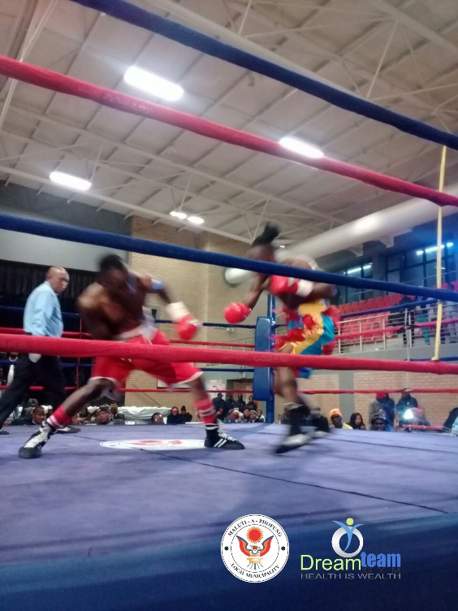
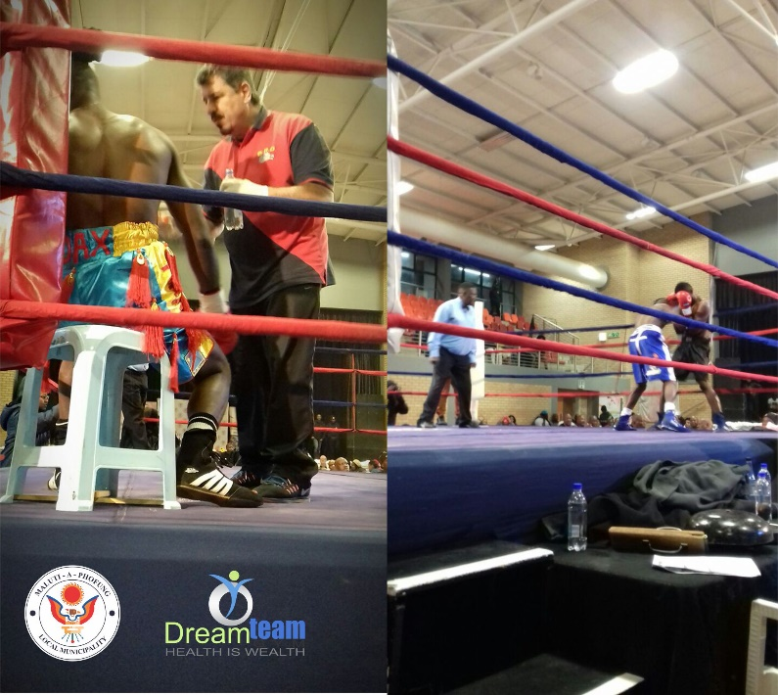
SPONSORSHIPS FOR BOXING
The sport is reduced to a step child of other sporting codes. Due to insufficient sponsorship, insufficient broadcasting of the up and coming boxers and a lack of interest in the sport from the youth, boxing is experiencing difficulties in the rural arrears.

Slide 9
CONCLUSION
BSA enter the space of Municipality negotiations for early development of Professional boxer
BSA to start a road show of introduction to various Provinces and state their strategic objectives about boxing.
Black Business Council need to be engaged to start taking interest in sponsorship of sport of Boxing
Transformation must be prioritized and BEE status and other incentices be offered to companies sponsoring boxing.
Broadcasting rights must be paid by Broadcasters.

Slide 10
CONCLUSION

